Slide 1
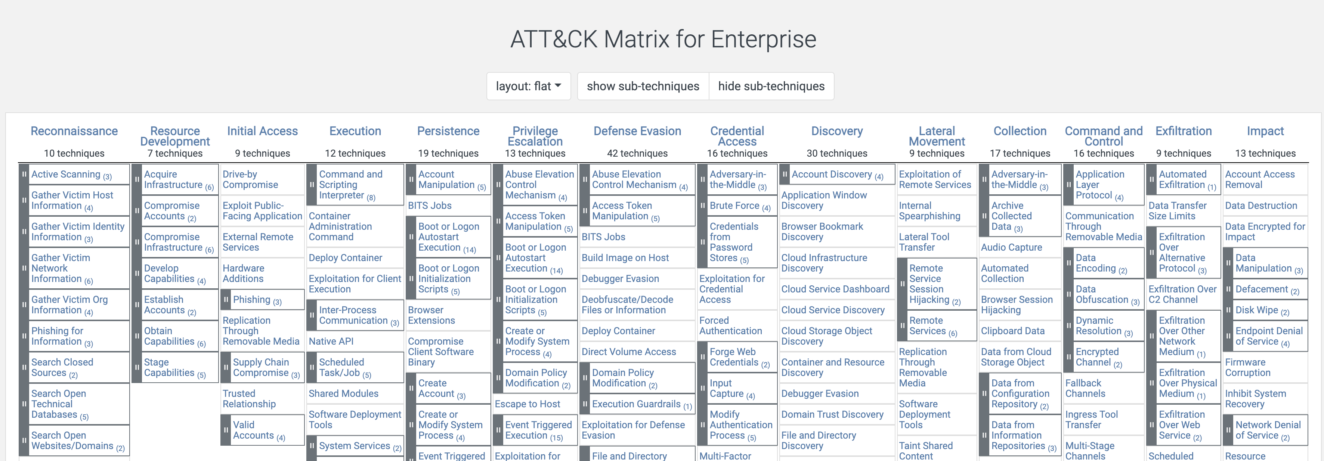
MITRE ATT&CK
https://attack.mitre.org/
Today we will be looking at defense evasion.

Slide 2
Defense Evasion

Slide 3
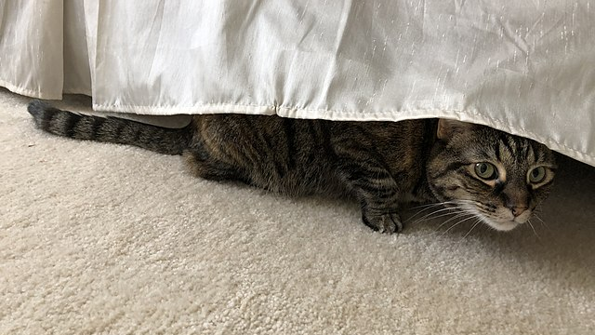
Defense Evasion
Rooms full of people like us, work hard to make it difficult to compromise systems and environments to carry out attacker objectives such as Ransomware delivery / Double Extortion.
Since mature organizations have a wide range of security controls, along with evolving and adaptive response capabilities, attackers are also working hard to find ways to achieve their objectives unimpeded and without detection.
Defense Evasion is the art and science of finding ways around controls and detective mechanisms. This topic goes deep, so we will just scratch the surface.
This Photo by Unknown Author is licensed under CC BY-SA

Slide 4
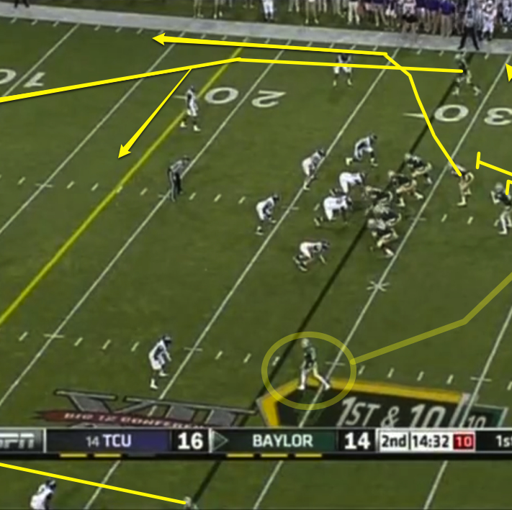
A few examples of Defense Evasion include:
Exploitation for defense evasion/disable tools.
GPO modification.
Indicator removal.
Masquerading (make malicious things look ok).
Use default/local accounts, service accounts, or other powerful native capability.
Pass the hash (could also be lateral movement).
This Photo by Unknown Author is licensed under CC BY-NC-ND

